Slide 1

Gandhi Institute of Science and technology kholiguda,Rayagada,odisha Seminar : NanoTechnology
Kothakota Aaksshay Kumandan
Branch :CSE B.Tech
Regd No :1901317069

Slide 2


Slide 3

What is Nano and Technology
A Nanometer is a unit of length in the metric system ,equal to one billion of a metre(10-9)
.Technology is the making ,usage and knowledge of tools ,machines and techniques ,in order to solve a problem or perform a specific function.

Slide 4

Definitions
Nanotechnology is the study of manipulating matter on an atomic scale.
Nanotechnology refers to the constructing and engineering of the functional systems at very micro level or we can say at atomic level.
A Nanometer is one billion of a meter , roughly the width of three or four atoms .The average human hair is about 25,000 nanometers wide.

Slide 5

History
The 1st ever concept was presented in 1959 by the famous professor of Dr. Richard P.Feynman.
Invention of the scanning tunneling microscope in 1981 and the discovery of fullerance and the (c6o) in the nano technology.
The term "Nano-technology" had been coined by Norio Taniguchi in 1974.

Slide 6
The early 2000s also saw the beginnings of commercial applications of nanotechnology , although these were limited to bulk applications of nanomaterials.
Silver nano platform for using sliver-nanoparticles as an antibacterial agent .
Nanoparticle - based transparent sunscreens ,and carbon nanotubes for stain - resistant textiles.

Slide 7
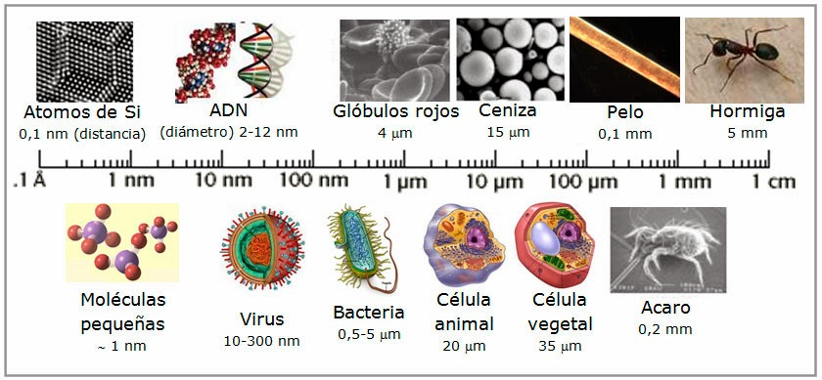

Slide 8

Tools And Technology
There are serval important modern developments.
The atomic force microscope(AFM).
The Scanning Tunneling Microscope (STM) are scanning probes that launched nanotechnology.
Various techniques of nanolithography
Optical Lithography
X- Ray Lithography
Dip pen nanolithography

Slide 9
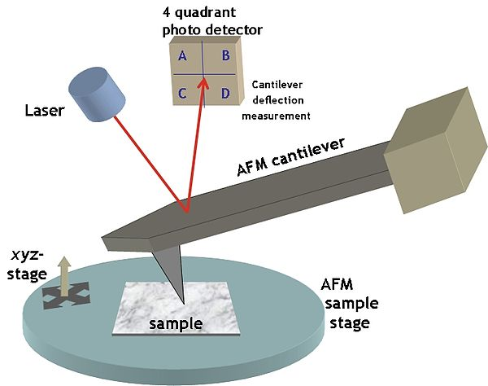
Electron beam lithography(inkjet printer) was developed.
Lithography is typical the transfer of pattern into photosensitive material by selective exposure to a radiation source such as light.

Slide 10
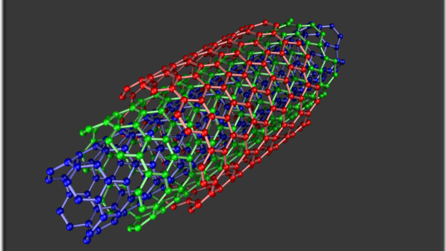
Carbon Nanotube
Carbon nanotubes are allotropes of carbon with a cylindrical nanostructure.
They have length –to-diameter ratio of up to 132,000,000:1
Nanotubes are members of the fullerene structure family.
Their name is derived from their long ,hallow structure with walls formed by one-atom thick sheets of carbon , known as graphene.

Slide 11

Properties of Carbon Nanotube
Highest strength to weight ratio ,helps in creating light weight spacecrafts.
Easily penetrate membranes such as cell walls ,it helps in cancer treatment.
Electrical Resistance changes significantly when other molecules attach themselves to the carbon atoms.
It helps in developing sensors that can detect chemical vapours.
This Photo by Unknown author is licensed under CC BY-SA.

Slide 12
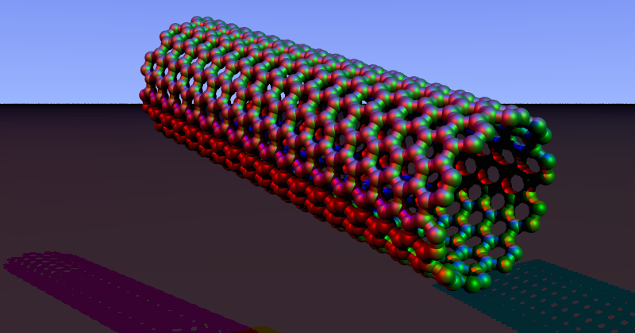
Applications Of Carbon Nano Tubes
Easton –Bell Sports ,Inc. using CNT in making bicycle component.
Zyvex Technologies using CNT manufacturing of light weight boats.
Replacing transistors from the silicon chips as they are small & emit less heat.
In electric cables & wires.
In solar cells
In Fabrics

Slide 13

Nanobots
Close to the scale of 10^-9.
Largely in R &d phase.
Nanobots of 1.5 nanometers across ,capable of counting specific molecules in a chemical sample.
Since nanorobots would be microscopic in size, it would probably be necessary for very large numbers of them to work together to perform microscopic & macroscopic tasks.
Capable of replication using environmental resources.
This Photo by Unknown author is licensed under CC BY-SA.

